Slide 1

ARCHERYSEC
Enhanced Containerized Vulnerability Assessment
and Scanning Platform
Automated Scheduling | Multi-Scanner Orchestration | Rich Reporting
Immanuel Milad Moawad Indrawes • TP077928
B.Sc. (Hons) Computer Science (Cyber Security)
Supervisor: Ms. Noris Ismail | 2nd Marker: Dr. Julia Juremi
Asia Pacific University of Technology & Innovation | 2026
Notes:
[Sources]
- User-provided FYP report: IR_TP077928_Immanuel_Miald_Mowad_Indrawes.docx.
[/Sources]

Slide 2
Project Aim & Objectives
What the project set out to achieve
PROJECT AIM
FIVE OBJECTIVES
To design and develop an improved ArcherySec vulnerability management system that strengthens scanning reliability, access governance, DevSecOps automation, and resilient digital infrastructure in alignment with SDG 9.
Identify limitations of the existing ArcherySec platform.
Design a reproducible Docker and Docker Compose architecture.
Implement scanner orchestration, scheduling and configurable scans.
Improve normalization, CVSS-based scoring, reporting and RBAC.
Evaluate functionality, performance, effectiveness and SDG 9 alignment.
ARCHERYSEC SAAS
TP077928 | FYP PRESENTATION
Notes:
[Sources]
- User-provided FYP report: IR_TP077928_Immanuel_Miald_Mowad_Indrawes.docx.
[/Sources]

Slide 3
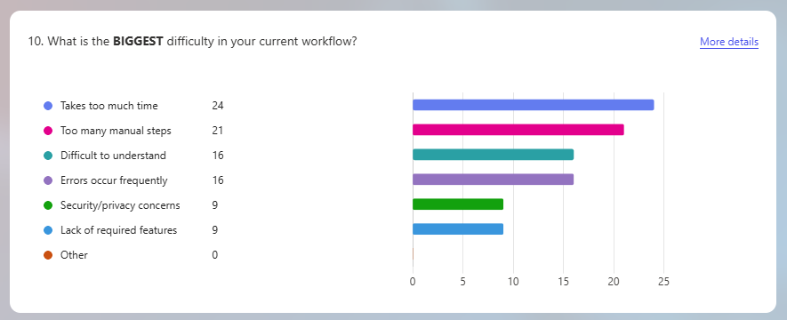
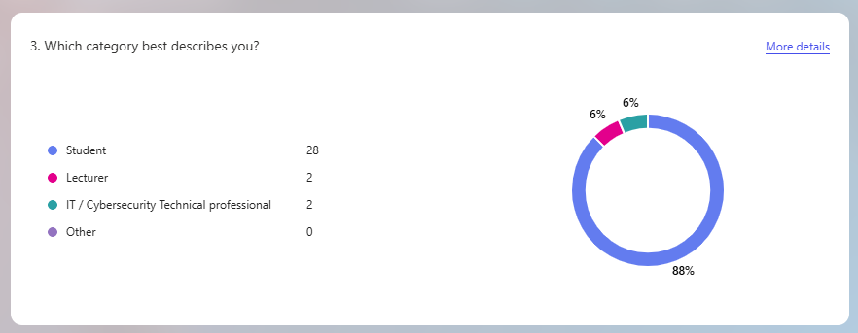
Questionnaire Findings
32 valid respondents informed the system requirements
RESPONDENT PROFILE
CURRENT WORKFLOW CHALLENGES
88% students, 6% lecturers and 6% IT/cybersecurity professionals.
Main issues: time-consuming work, too many manual steps, difficulty interpreting results, and execution errors.
ARCHERYSEC SAAS
TP077928 | FYP PRESENTATION
Notes:
[Sources]
- User-provided FYP report: IR_TP077928_Immanuel_Miald_Mowad_Indrawes.docx.
[/Sources]

Slide 4
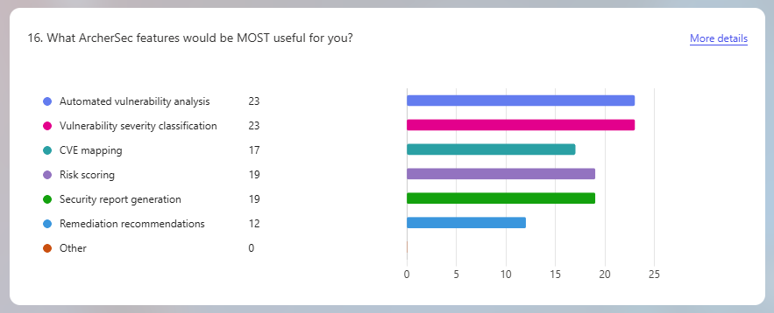
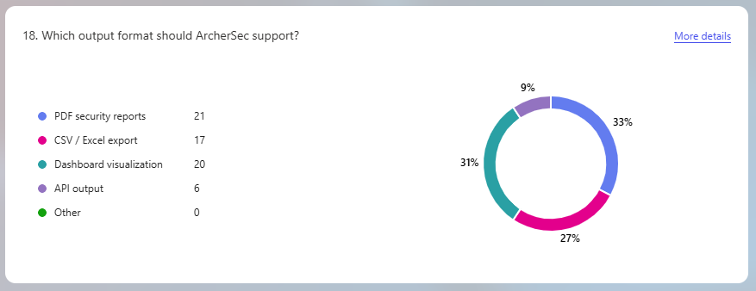
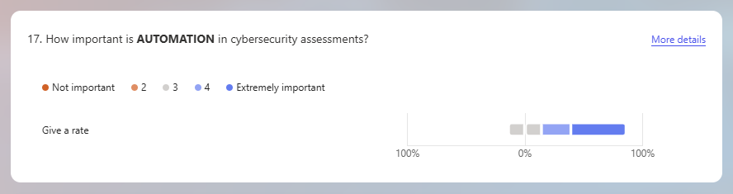
Questionnaire Findings
Features and outputs most valued by respondents
MOST USEFUL FEATURES
AUTOMATION
OUTPUT FORMATS
Automated analysis, severity classification, risk scoring and reporting received the strongest support.
20 respondents rated automation as important or very important.
PDF reports and dashboard visualizations were the preferred outputs.
ARCHERYSEC SAAS
TP077928 | FYP PRESENTATION
Notes:
[Sources]
- User-provided FYP report: IR_TP077928_Immanuel_Miald_Mowad_Indrawes.docx.
[/Sources]

Slide 5
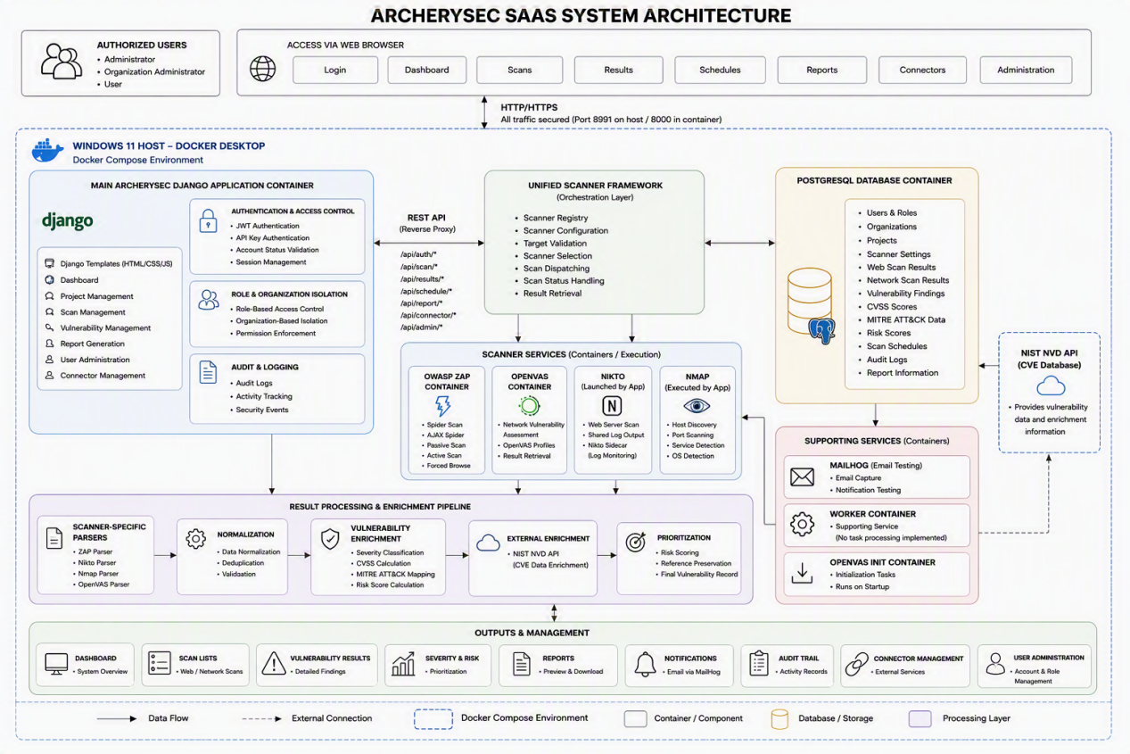
System Architecture
Containerized, multi-tenant and scanner-oriented design
ARCHERYSEC SAAS
TP077928 | FYP PRESENTATION
Notes:
[Sources]
- User-provided FYP report: IR_TP077928_Immanuel_Miald_Mowad_Indrawes.docx.
[/Sources]

Slide 6
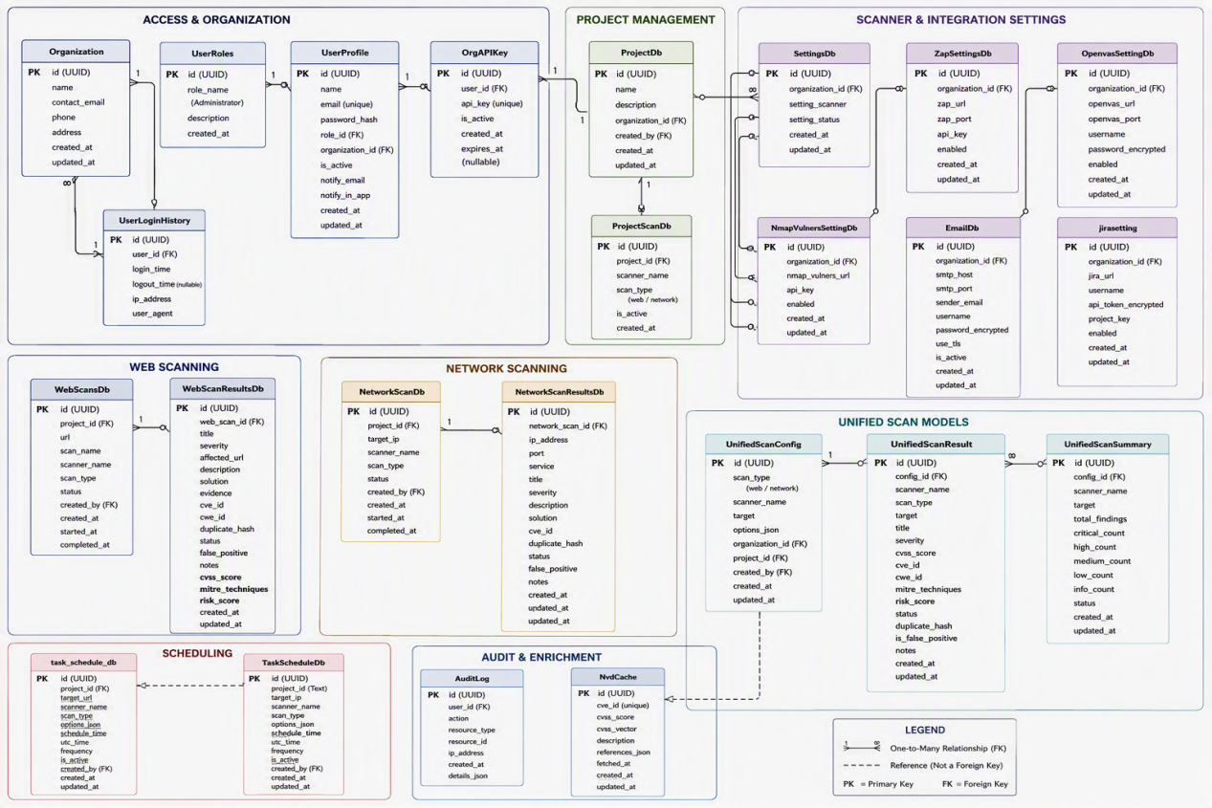
Database Design & ERD
Core data entities and relationships
ARCHERYSEC SAAS
TP077928 | FYP PRESENTATION
Notes:
[Sources]
- User-provided FYP report: IR_TP077928_Immanuel_Miald_Mowad_Indrawes.docx.
[/Sources]

Slide 7
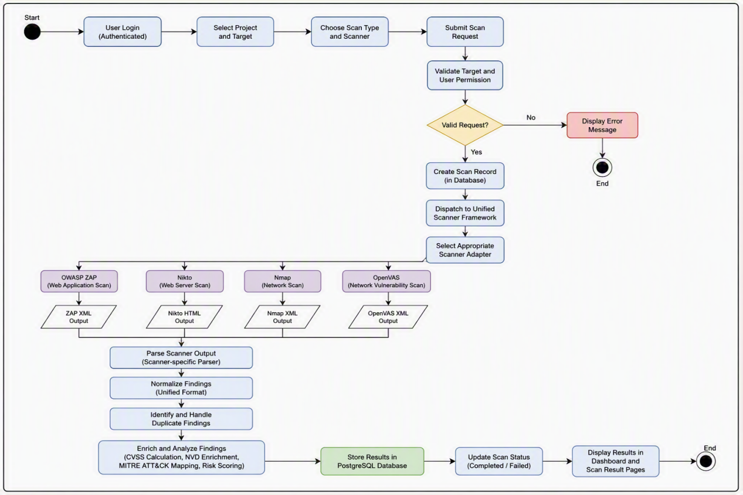
Vulnerability Scan Execution Flow
From authenticated request to analyzed findings
ARCHERYSEC SAAS
TP077928 | FYP PRESENTATION
Notes:
[Sources]
- User-provided FYP report: IR_TP077928_Immanuel_Miald_Mowad_Indrawes.docx.
[/Sources]

Slide 8
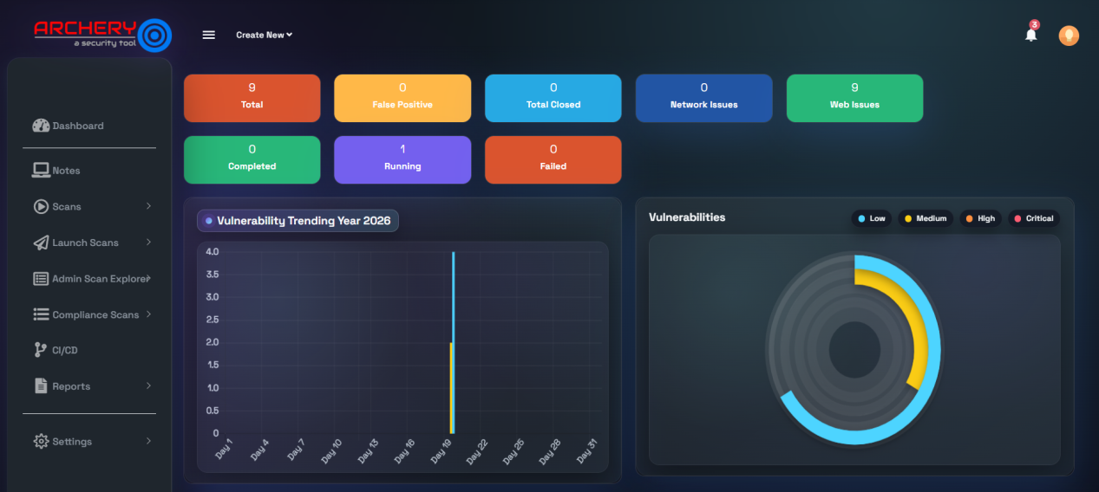
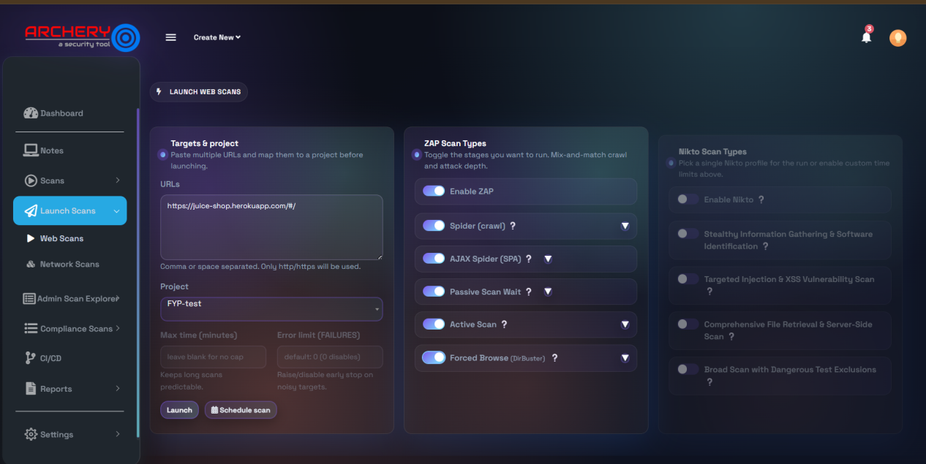
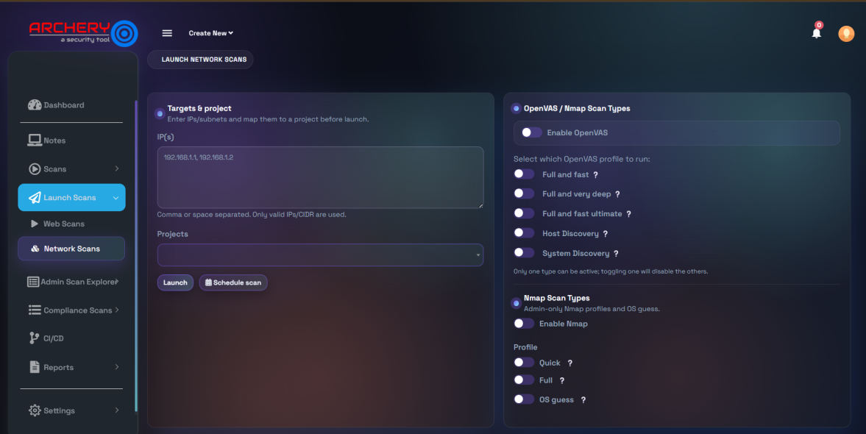
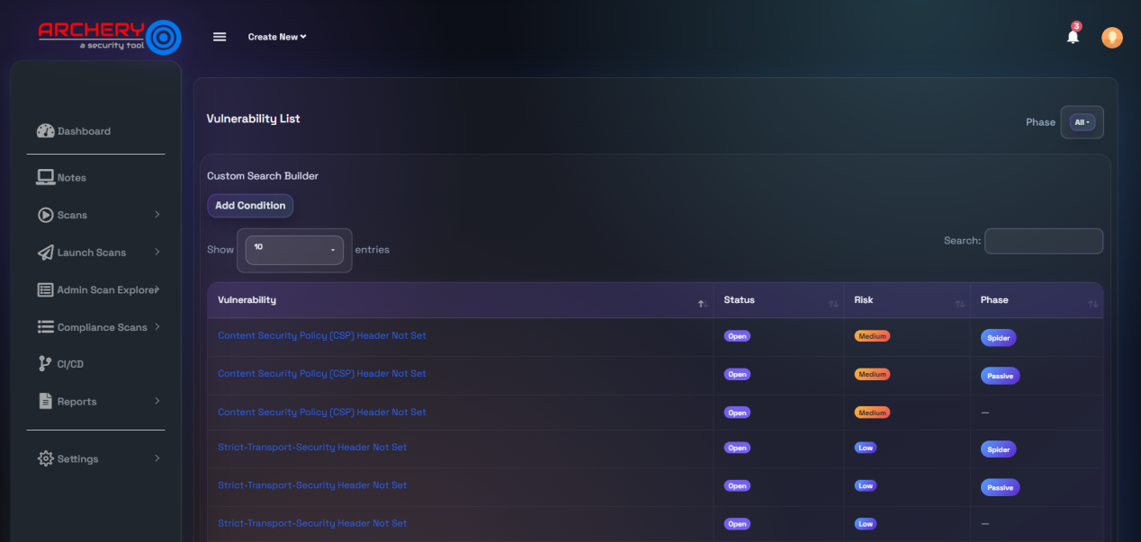
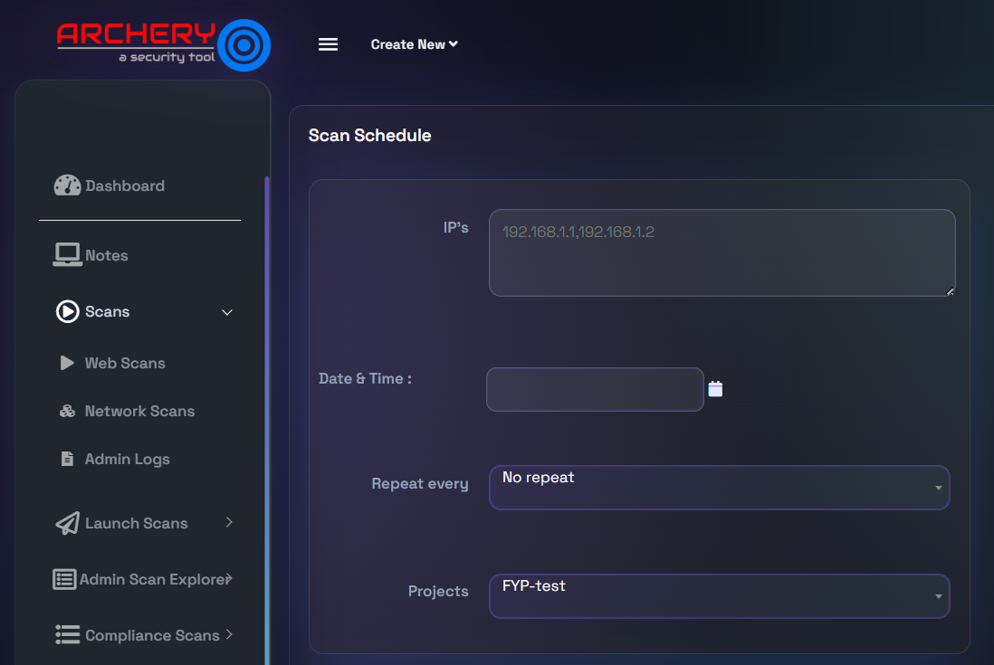
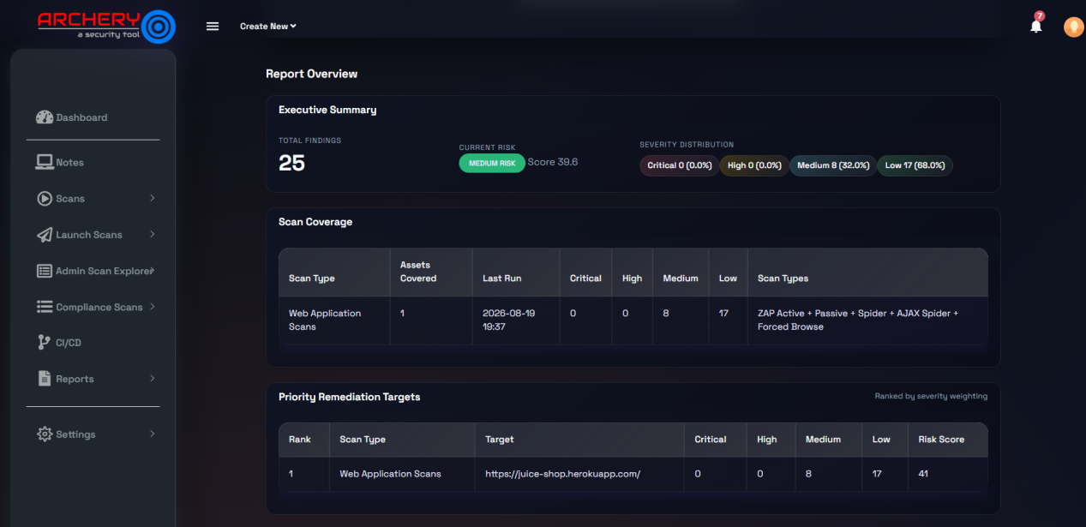
System Interface
Selected screens from the implemented platform
Dashboard
Launch Web Scan
Launch Network Scan
Vulnerability Results
Scan Scheduling
Report Preview
ARCHERYSEC SAAS
TP077928 | FYP PRESENTATION
Notes:
[Sources]
- User-provided FYP report: IR_TP077928_Immanuel_Miald_Mowad_Indrawes.docx.
[/Sources]

Slide 9
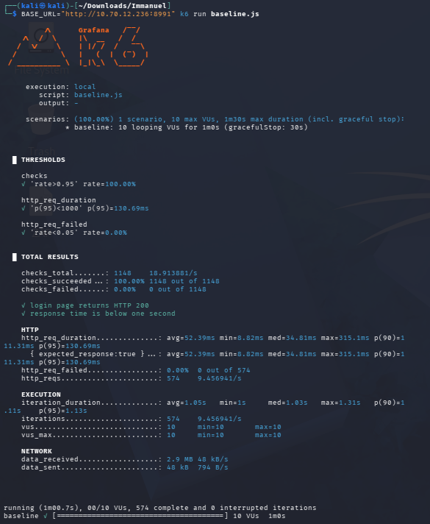
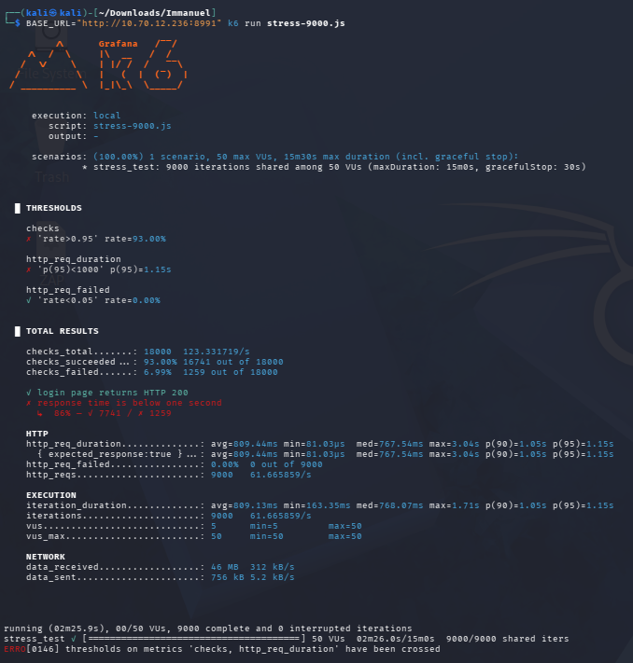
Testing & Results
Unit, functional and stress testing evidence
25 / 25
8
9,000
0.00%
1.15 s
TESTS PASSED
DEFECTS CORRECTED
STRESS REQUESTS
HTTP FAILURES
P95 AT 50 VUs
BASELINE k6
MAIN STRESS TEST
ARCHERYSEC SAAS
TP077928 | FYP PRESENTATION
Notes:
[Sources]
- User-provided FYP report: IR_TP077928_Immanuel_Miald_Mowad_Indrawes.docx.
[/Sources]

Slide 10
User Acceptance Testing
Three perspectives: lecturer, professional and student
Tester 1 • Lecturer
Tester 2 • Professional / Admin
Tester 3 • Student
PASS
PASS
PASS
Dashboard, scanner integration and reporting accepted.
RBAC, result ingestion and role-based views accepted.
Severity indicators, filtering and visual summaries accepted.
Overall UAT result: Accepted
Overall UAT result: Accepted
Overall UAT result: Accepted
Main strengths identified: usability, dashboard clarity, vulnerability filtering, scanner result ingestion, role-based access and report generation.
ARCHERYSEC SAAS
TP077928 | FYP PRESENTATION
Notes:
[Sources]
- User-provided FYP report: IR_TP077928_Immanuel_Miald_Mowad_Indrawes.docx.
[/Sources]

Slide 11
Project Limitations
Key boundaries of the completed evaluation
MAIN LIMITATIONS
Testing was conducted in a controlled local Windows 11 and Docker environment.
Response time increased under the 50-user workload, although all requests completed.
End-to-end verification depth differed across supported scanner integrations.
Scheduling initialization was verified, but complete timed execution needs broader observation.
UAT involved three representative participants.
Production-scale deployment and security hardening remained outside the project scope.
ARCHERYSEC SAAS
TP077928 | FYP PRESENTATION
Notes:
[Sources]
- User-provided FYP report: IR_TP077928_Immanuel_Miald_Mowad_Indrawes.docx.
[/Sources]

Slide 12
Future Enhancements
Recommended directions for continued development
TECHNICAL ENHANCEMENTS
USER & PLATFORM ENHANCEMENTS
Optimize application and database performance.
Expand end-to-end validation for every scanner.
Strengthen automation and scheduled execution.
Prepare the platform for larger deployment environments.
Provide organization-specific report customization.
Evaluate additional security-assessment capabilities.
Extend testing to a larger and more diverse user group.
Continue supporting resilient digital infrastructure under SDG 9.
ARCHERYSEC SAAS
TP077928 | FYP PRESENTATION
Notes:
[Sources]
- User-provided FYP report: IR_TP077928_Immanuel_Miald_Mowad_Indrawes.docx.
[/Sources]

Slide 13
THANK YOU
Questions & Discussion
ArcherySec SaaS • Immanuel Milad Moawad Indrawes • TP077928
Notes:
[Sources]
- User-provided FYP report: IR_TP077928_Immanuel_Miald_Mowad_Indrawes.docx.
[/Sources]

